Slide 1
Pulse@KPU
Information on community events and happenings at Kwantlen Polytechnic University.
By Ken Yau & Hilal Malik

Slide 2
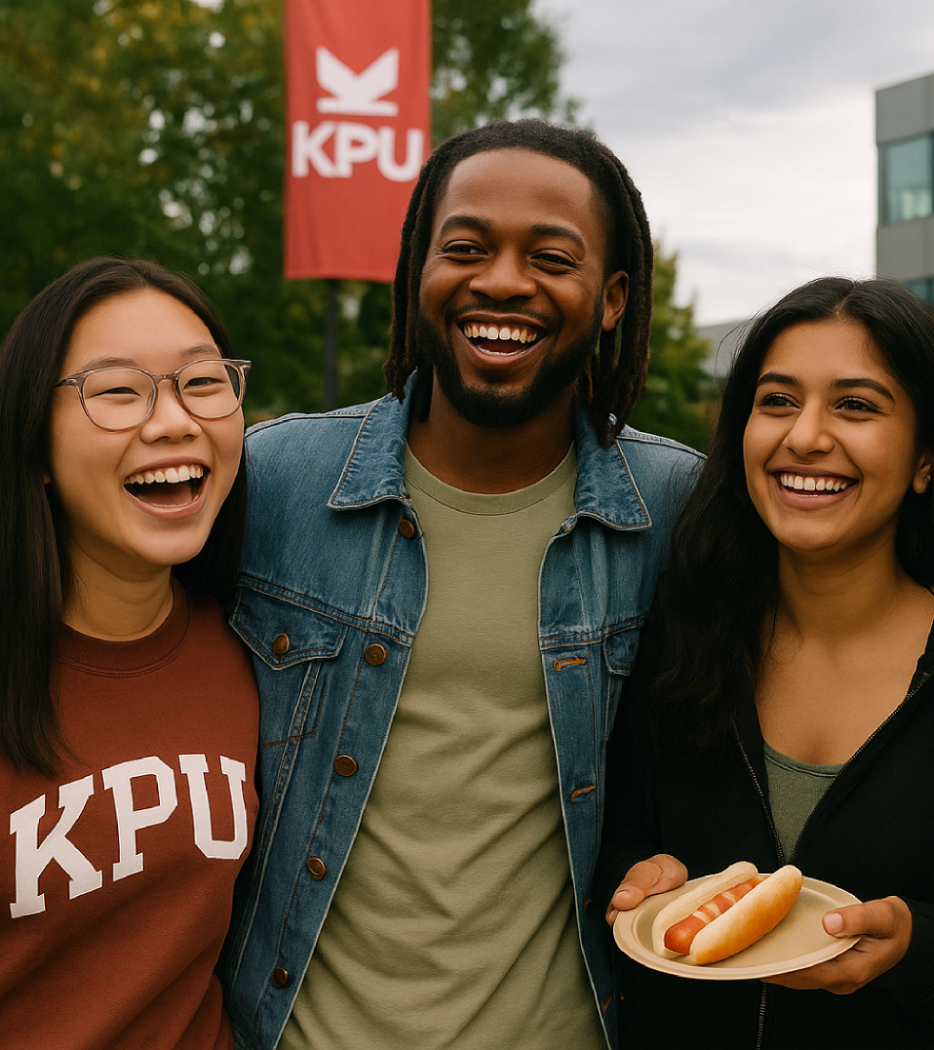
Project General Overview
The Pulse@KPU Events Web App aims to centralize and streamline the way students, faculty, and staff access information about events happening across KPU campuses.
This project was inspired by my time working as an Events Assistant last semester, and the challenges we faced getting students informed about the various events that we had planned.
Our objective with this app is improve awareness of events, increase student participation, and enhance the sense of community across KPU.

Slide 3
Project Description
Target Audience: The primary target audience includes KPU students, followed by faculty, staff, and external community members interested in attending public KPU events.
The tool serves both events coordinators at the University, as well as students who are looking to get more involved in campus activities.
Product Features:
Browse events by dates or categories
Search and filter events by keywords or campus location
View event details such as time, venue, description, and organizers
Add events to personal calendars
Access multimedia like images and videos associated with the events
Intended use: The app will used by students and staff to stay informed about upcoming opportunities, workshops, and happenings on campus.
“
Coming together is a beginning; keeping together is progress; working together is success
— HENRY FORD

Slide 4
26 JUNE 2024
Need it fulfills:
KPU students and staff currently don’t have a single, centralized tool to view or manage campus events. Currently events are advertised by mass emails sent from administrators.
Goal it addresses:
Provide an user friendly platform where students can view upcoming events in a list or calendar format, and admins can post new events in real-time, without the need to use emails as the primary source of communication.

Slide 5
26 JUNE 2024
The end goal is for our app to create a more enriched learning environment for students by facilitating stronger community, relationships, and connections - an essential part of the post-secondary experience.
Impact:

Slide 6



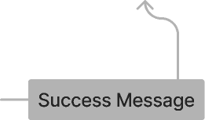


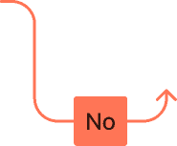
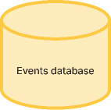
User Flow for Students & Normal Users
Register For and Event
Events Feed
Registration Modal
Refreshed Feed
End
Logged in?
Open Pulse@KPU

Slide 7
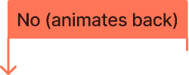


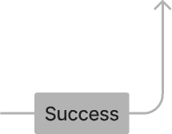

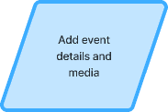
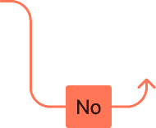
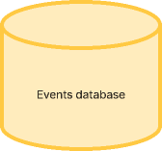
User Flow for Admins
Post an event?
Events Feed
Post Modal
Refreshed Feed
End
Logged in?
Open Pulse@KPU

Slide 8





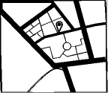








Wireframes
Our initial concept of the app could include a search bar at the top of the screen, allow users to search for events using key words and phrases.
When users click on an event card, it brings up a detailed events page with the option to join or share the event using the buttons at the bottom of the interface.
Event Title
Details

Slide 9
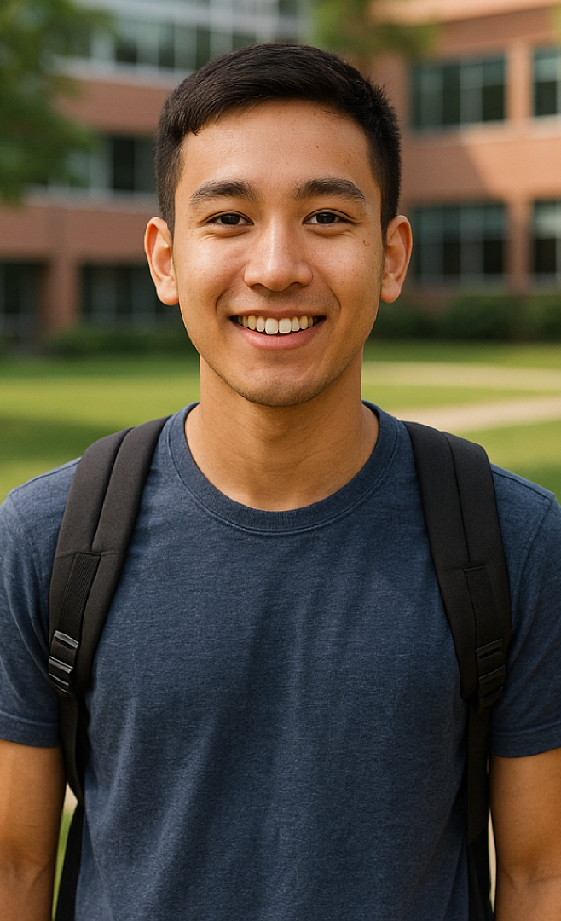
More Information
Age:
21
Education:
Design
Status:
Single
Location:
Richmond, BC
Background
Neville is a first-time international student at Kwantlen Polytechnic University (KPU). He has recently arrived in Canada, so he’s not only adjusting to a new academic environment but also learning to navigate life in a new country. As a newcomer, John may feel a mix of excitement and uncertainty
Goals
Frustration
Neville’s current goal is to attend events happening across KPU campuses so he can meet new people, connect with other students, and make friends. He sees campus events as a safe, fun, and structured way to break the ice, learn more about Canadian student life, and ease feelings of isolation that often come with moving abroad.
Neville often feels frustrated because event details at KPU are scattered across different platforms, making it hard to know what’s happening and where. He also worries about showing up alone, struggles with transportation between campuses, and sometimes hesitates to join conversations due to language and cultural barriers.
Neville
ROLE
International Student

Slide 10

More Information
Age:
21
Education:
High School
Status:
Single
Location:
Vancouver, BC
Background
Alisa is a student at Kwantlen Polytechnic University (KPU) that is currently working as an events assistant at the Wilson School of Design campus in Richmond, BC. She volunteered as a part of student counsel during High School, and desires to continue to hone her skills at event planning and logistics at the University.
Goals
Frustration
She hopes to create some fun events that will resonate with the other students at KPU. Her hope is to network and build new friendships with other students. Besides that, she also wants to build a better sense of community on her campus.
Currently each time she plans an event, an email needs to be sent out to the entire student population. This is both time consuming and ineffective. Students that attend other KPU campuses also do not receive the emails, which limits attendees to students within the Wilson School of Design.
Alisa Thompson
ROLE
Campus Events Coordinator

Slide 11



Project Technical Requirements
The KPU Events Web App will be developed using the following technology stack:
React JS – Provides a modern, component-based framework for building interactive and responsive user interfaces.
Supabase – Serves as the backend platform, offering authentication, a real-time database, file storage, and APIs to keep event data synchronized.
TailwindCSS – Enables quick styling with responsive design built in.
Shadcn/UI & Hero Icons – Supplies pre-built, accessible components and icons, which can are optimized to be integrated with Tailwind CSS for a polished interface.
FullCalendar – Provides an interactive, dynamic calendar view to display event data directly from the database.
As students in our final year, this tech stack demonstrates our ability to build modern web apps that bring real value to our community. These technologies are widely adopted, well-documented, and provide the tools needed to deliver a professional-grade project.
React JS
Tailwind CSS
Supabase

Slide 12
Core Components
The following outlines the key planned components to enable the functionality for Pulse@KPU.
<header />
  Contains the logo, navigation, and login/logout functions for the user. Supabase will be used for ID authentication and role-based access.
<main />
  Shows either the list of posts or calendar view. This section dynamically shows the content based on the user selected view option.
<posts />
  List the posts and upcoming events. A table on Supabase will handle the storage of event details, including the title, date, and description.
<calendar />
  Displays upcoming events in a calendar view, linked to the event database. Initial plans is to use FullCalendar to implement this feature.
<admin />
  Restricted to approved admins for posting events. Using Supabase’s role management with RLS policies, only the users with admin access will see a component allowing them to post new events.

Slide 13
Key screens and components:
Header / Navigation - provides branding and navigation links
Search bar with functionality
Hamburger menu with various options such as account profile and user calendar
Home screen with login functionality for both students, general users, and admin
Events page showing a feed of upcoming events being updated in realtime from the Supabase API.
Login screen, showing user authentication supported by Supabase. RLS policy management is handled through Supabase, which allows admin users to have access to event posting features.
An events posting modal that is accessible by admin using role-based assess.
MVP Roadmap
Our minimum viable product map lists out the key screens and components we will need to create in order to provide the base functionality of our app.
The aim is to get Pulse@KPU to a point where it provides real use for our users, which will allow us to conduct user testing and analysis.
User feedback will inform us on where we can continue to build and take our web app next.

Slide 14



















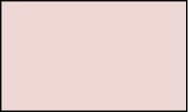




26 JUNE 2024
Development Roadmap
01 RESEARCH
02 STRATEGY
03 DESIGN
04 DEVELOPMENT
Kickoff
User Journey Map
Low Fidelity Wireframes
Mid Fidelity Wireframes
High Fidelity Prototype
Supabase Database and API Creation
Live working MVP Tests and user recruitment
Project Plan Document
UX Personas
Usability testing
User feedback
Development with React, Tailwind CSS, Shadcn, Hero Icons
Site Navigation Map

Slide 15
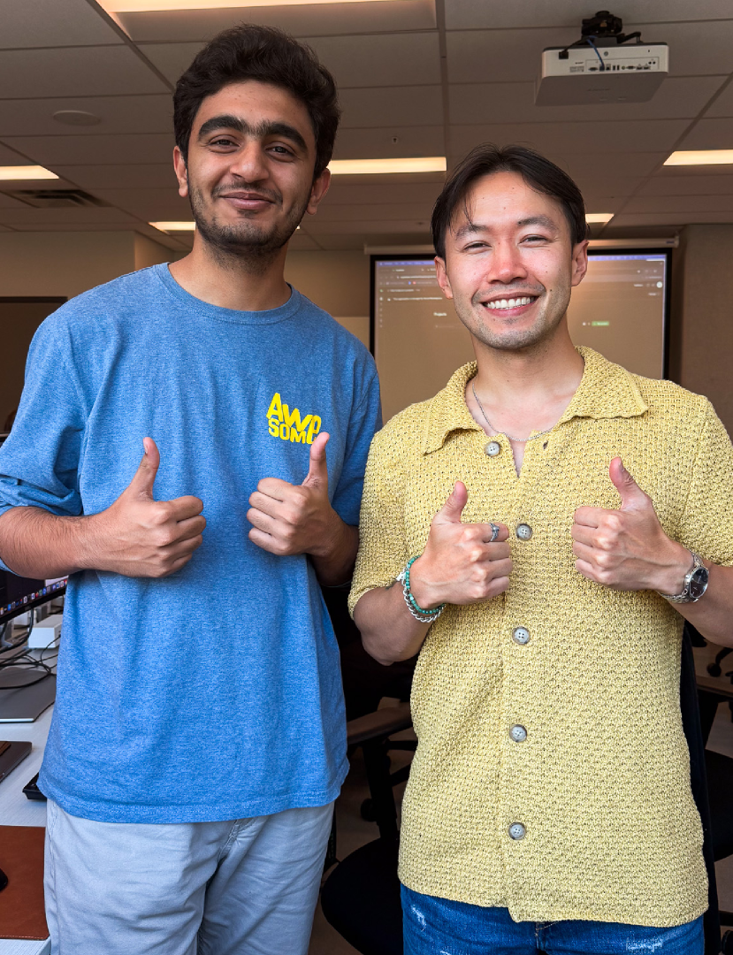
Project Rationale
The purpose of this project is to build our development skills by working with React while leveraging Supabase as a backend solution to support our design.
Beyond being a technical exercise, the project is conceived as a meaningful portfolio piece: something that provides genuine value for the KPU community and can serve as a foundation for future growth. Our goal is to demonstrate not only technical competence, but also the ability to design scalable solutions that address real user needs and can evolve over time.
Ultimately, our goal with any project in our program is to build our skills and open doors for work in front end development after graduation. Using React, which one of the most widely used tools in modern web development will demonstrate for potential employers that we are ready to enter the workforce upon graduation.

Slide 16
Future Roles and Project Value
This semester is the first time we are being exposed to using React to build user interfaces. This presents an exciting opportunity for us to create experiences that are more engaging and dynamic than anything we have created in the past. The skills we gain with React, combined with integration of modern backend tools like Supabase, will be extremely valuable to highlight in our portfolios and demonstrate to potential employers.
Because this project takes us all the way from UX conceptualization to development, it provides genuine, hands-on experience with the full product lifecycle. Our program at KPU is unique in that we are developing skills in both design and development. This project will showcase how these strengths translate into a fully working product from conceptualization to deployment - evidence that we can contribute to multidisciplinary teams after graduation.

